Slide 1
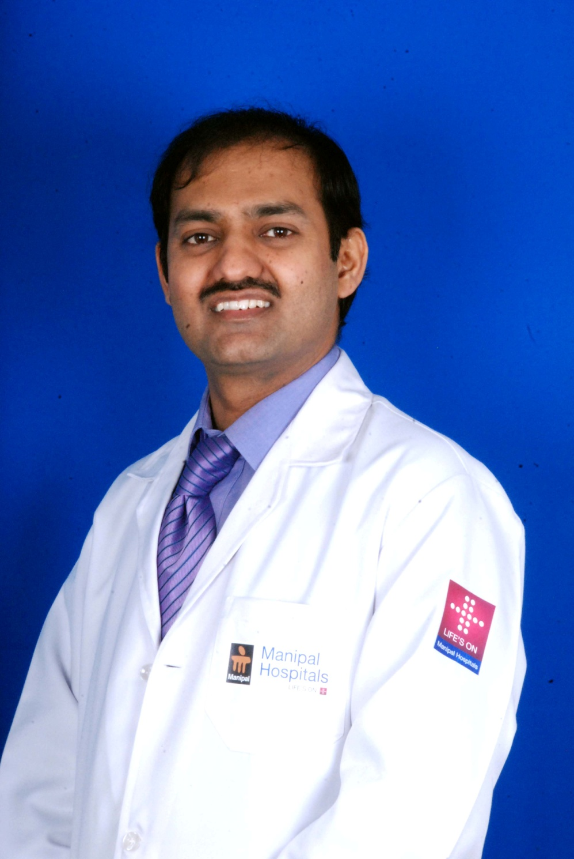
Prof. Dr.Somashekhar.S.P
MBBS, MS, MCh(Onco), FRCS.Edinburgh
Chairman, Oncology, Manipal Cancer Center
HOD department of Surgical & Gynec. Oncology HIPEC
Manipal Comprenensive Cancer Center, Manipal University , Manipal Hospital, Bangalore, India
Director HIPEC programme
Director of robotic surgery fellowship, Manipal university
MCh- Oncosurgery from Regional Cancer Center, Ahmedabad with University Gold Medal
Fellow of Royal college Of surgeons from Edinburgh
Receipent of Gujarat university GOLD MEDAL and record holder
Director of robotic surgery fellowship, Manipal University
Hon Secretery ISPSM HIPEC India society
Executive member Int society of Pleura and Peritonrum ISSPP
Editor In Chief , Springer Indian Journal of Gynec Onco
Council member AGOI: Association of Gynec Oncology India
PRESIDENT elect ABSI Associstion of Breast Surgeons Of India
Has been awarded prestigious Dr.D.D.Patel Gold Medal for excellency in Oncosurgery
Gujarat University Gold medal
Author of several text books of Oncology
Over 200 peer reviewed articles in Journals
Gynec onco fellowship mayo clinic
Robotic fellowship from Roswell cancer center USA
Director Board of Studies, Manipal University, Manipal Hospital
Has several publications in International and National Journals
Is Professor and HOD, Department of Surgical Oncology & Gynec oncology
Manipal Cancer Center, Bangalore and Robotic surgeon and Chairman oncology Manipal Health Enterprise
E mail: somusp@yahoo.com

